Slide 1
Continuous Integration

Slide 2
CI
Continuous Integration is a development practice that calls upon development teams to ensure that a build and subsequent testing is conducted for every code change made to a software program

Slide 3
To whom it is helpful
Continuous integration has become a very integral part of any software development process. It will help the software testing professionals who would like to learn how to build and test their projects continuously in order to help the developers integrate the changes to the project as quickly as possible and obtain fresh builds.

Slide 4
About CI
Continuous Integration was first introduced in the year 2000 with the software known as Cruise Control.
Why Continuous Integration?
top 7 reasons why we think you should be using CI and why you should consider it from the beginning of your project.

Slide 5
1. Run your tests in the real world
Have you ever had your tests pass on your machine, but fail on someone else's? Well, with CI you can avoid that embarrassment. Just push your code to your new branch and the CI server will take care of running the tests for you. If everything is green, you can be sure that you didn't break anything. And if they fail for someone else, you have evidence that they are wrong.
2. Increase your code coverage
Think your tests cover most of your code? Well think again. A CI server can check your code for test coverage. Now, every time you commit something new without any tests, you will feel the shame that comes with having your coverage percentage go down because of your changes.
3. Deploy your code to production
You can have the CI server automatically deploy your code to production if all the test within a given branch are green. This is what is formally known as Continuous Deployment, or Oh my God, that was scary, I'm glad my code worked! in some circles.

Slide 6
4. Build stuff now
All your tests are green and the coverage is good, but you don't handle code that needs to be deployed? No worries! CI servers can also trigger build and compilation processes that will take care of your needs in no time. No more having to sit in front of your terminal waiting for the build to finish, only to have it fail at the last second. The CI server will run this for you within its scripts and notify you as soon as something goes wrong.
5. Build stuff faster
With parallel build support, you can split your tests and build processes into different machines, so everything will finish even faster than if you ran it locally. It will also consume less local power and resources, so you can continue working on something else while the builds run.
6. Don't break stuff
Having your code tested before and after it is merged will allow you to decrease the amount of times your master build is broken. Don't wait until it's too late, test yo-self, before you brake yo-self.
7. Decrease code review time
You can have your CI and Version Control Server communicate with each other and tell you when a merge request is good to merge. It can also show how the code coverage would be affected by it. This can dramatically reduce the time it takes to review a merge request

Slide 7
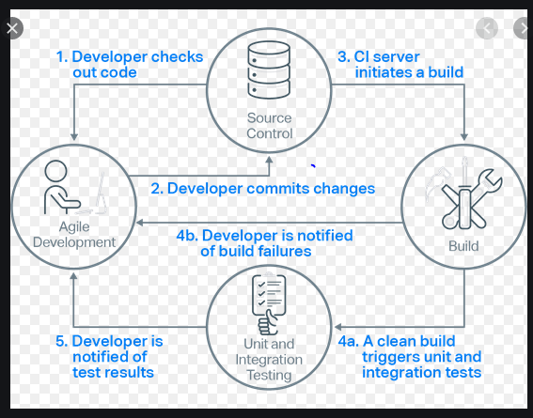
CI Workflow

Slide 8
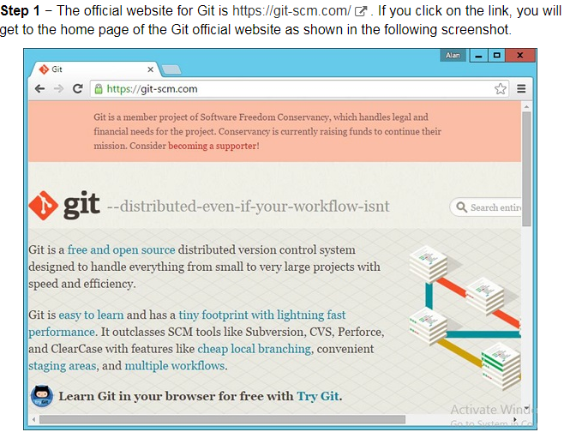
Softwares

Slide 9
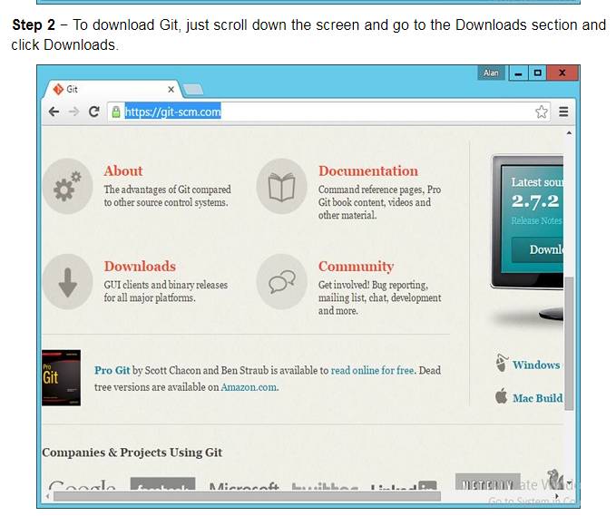
Step 2

Slide 10
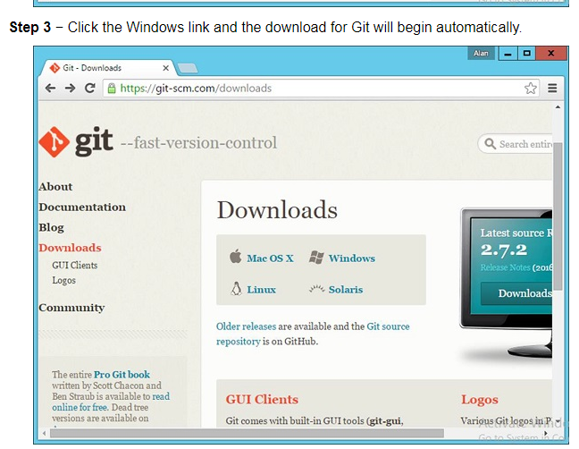
Step 3

Slide 11
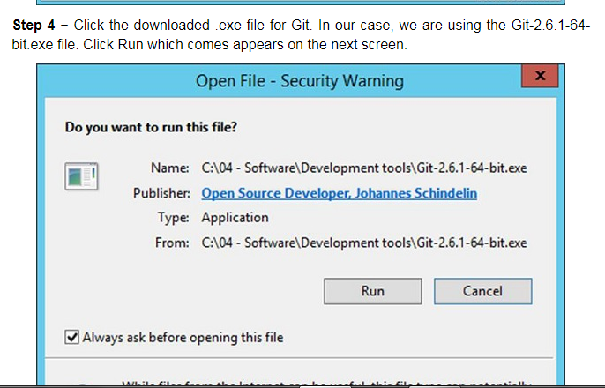
Step 4

Slide 12
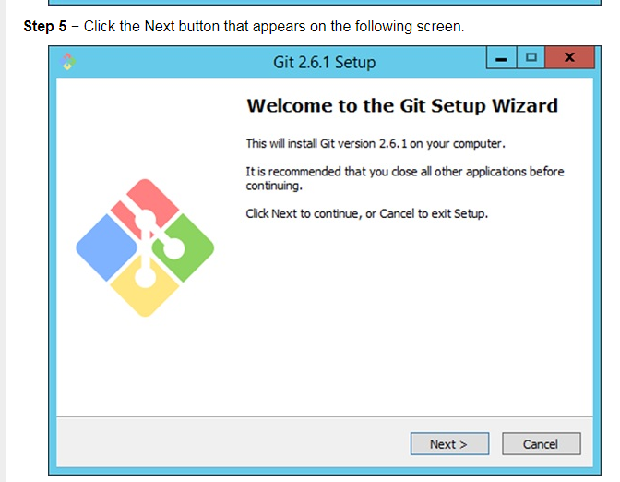
Step 5

Slide 13
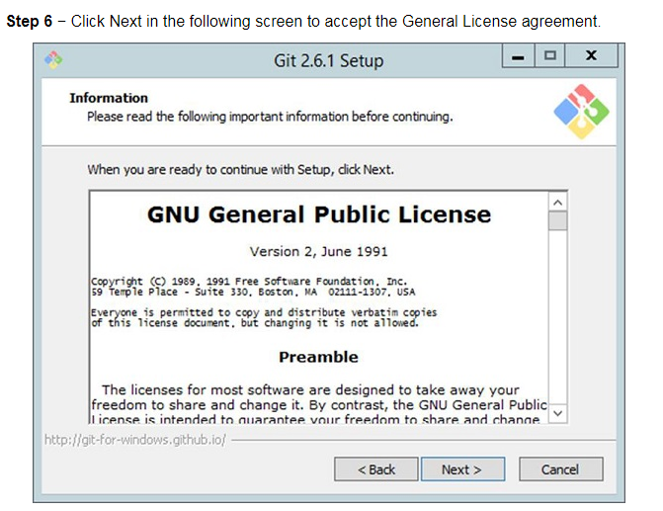
Step 6

Slide 14
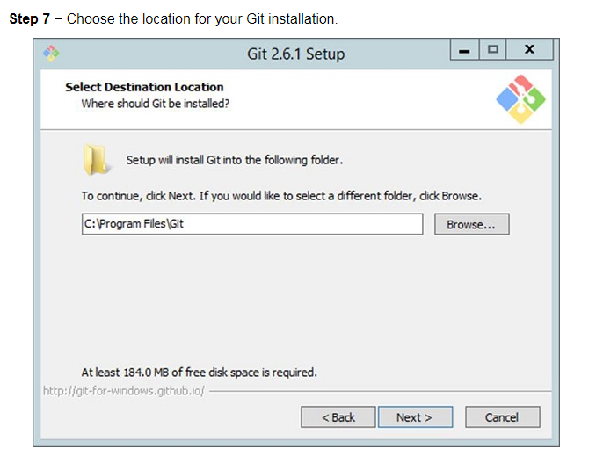
Step 7

Slide 15
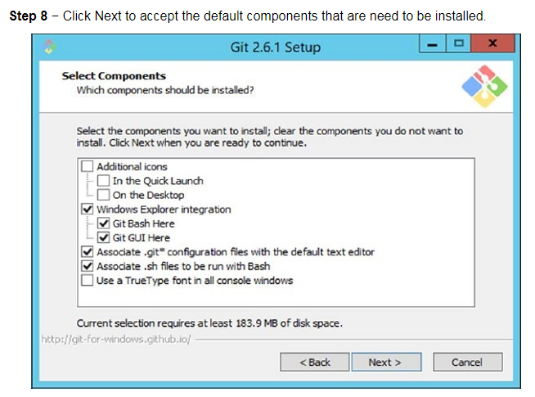
Step 8

Slide 16
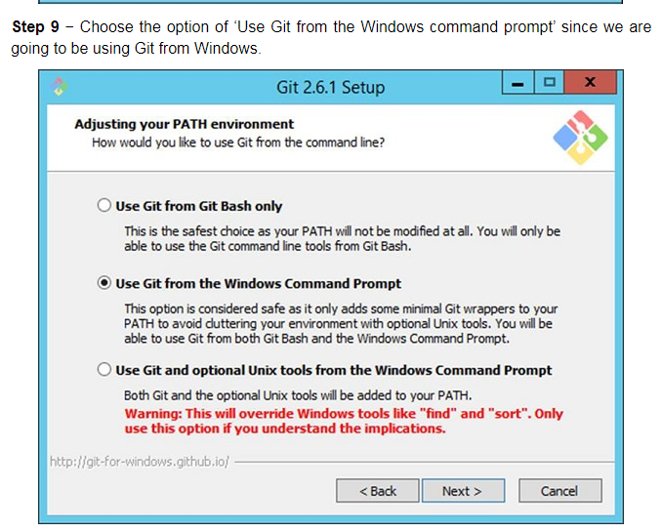
Step 9

Slide 17
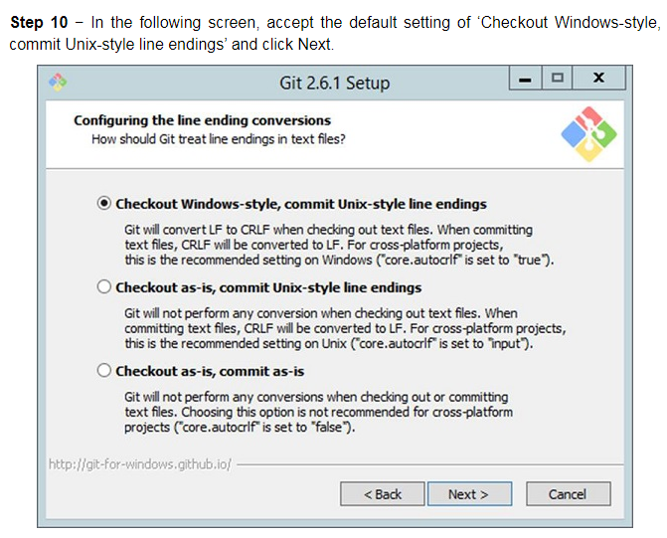
Step 10

Slide 18
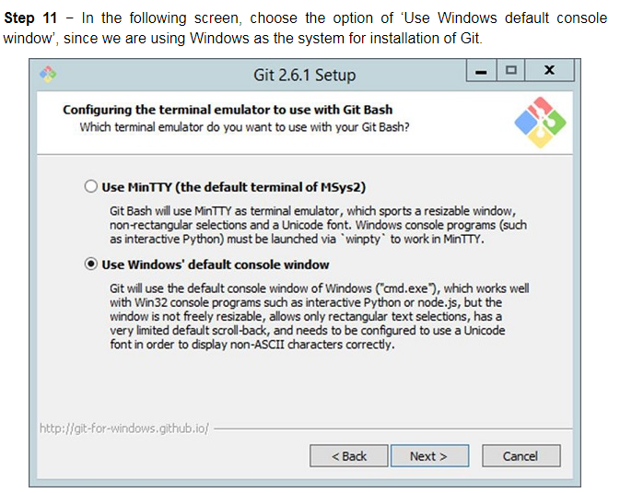
Step 11

Slide 19
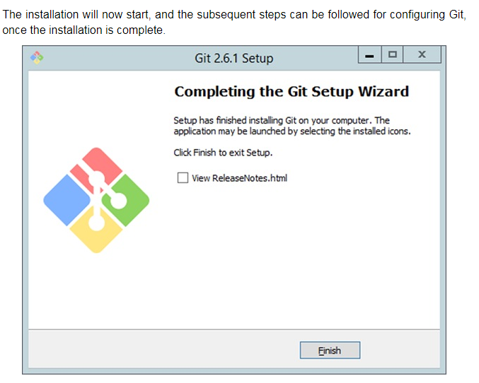
Step 12

Slide 20
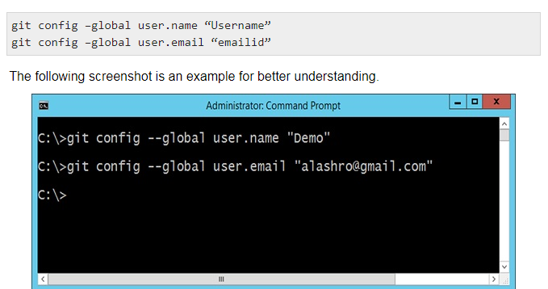
Configuring Git

Slide 21
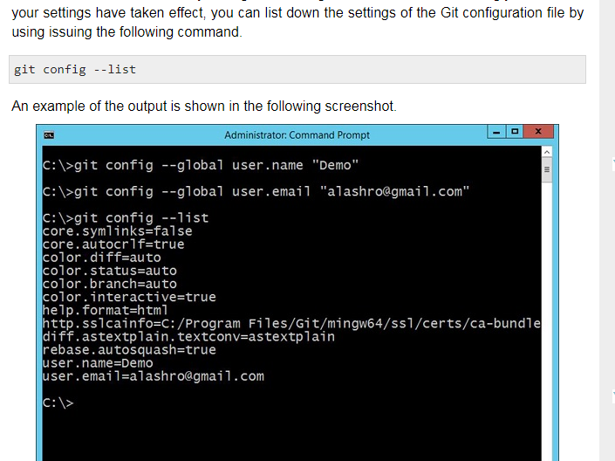

Slide 22
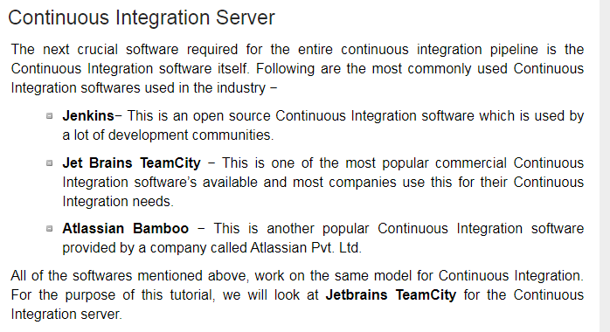

Slide 23
Jenkins
As an extensible automation server, Jenkins can be used as a simple CI server or turned into the continuous delivery hub for any project.
Easy installation
Jenkins is a self-contained Java-based program, ready to run out-of-the-box, with packages for Windows, Mac OS X and other Unix-like operating systems.
Easy configuration
Jenkins can be easily set up and configured via its web interface, which includes on-the-fly error checks and built-in help.

Slide 24
Install Jenkins
Step 1: Install Java Version 8
Step 2: Install Apache Tomcat 9
Step 3: Download Jenkins war File
Step 4: Deploy Jenkins war File
Step 5: Install Suggested Plugins

Slide 25
CD
Continuous delivery (CD), which is the process of ensuring your software is always ready for deployment. It goes hand-in-hand with the DevOps and agile movement. Deployments are available with the push of a button, and rollbacks (when necessary) are seamless.
Achieving continuous delivery bliss is the dream, but how do we get there? Just follow these commandments:
Establish continuous integration
Test
Test some more
Deploy when ready
Monitor
Before embarking on the CD journey, it’s important to reflect on the state of your team. Make sure all the pieces are in place and you feel confident that you’re ready for continuous delivery. Rome wasn’t built in a day, and neither was the CD dream team.

Slide 26
Steps
CI process can vary slightly based on a team’s preference, the essential steps are:
Build code
Send code to repository
Test code
Send back errors
Fix code
Repeat step 2 and 3

Slide 27
Understanding the CI/CD Pipeline: What It Is, Why It Matters
A CI/CD pipeline can be easily understood as the process pathway through which we can deliver a single unit of production-ready software. Your team will choose which services they’ll use to build this; there’s no single canonical implementation of a CI/CD pipeline.

Slide 28
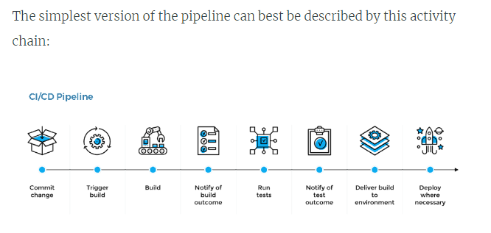

Slide 29
Steps to deploy in Azure
The Azure DevOps Project simplifies the setup of an entire continuous integration (CI) and continuous delivery (CD) pipeline to Azure with Azure DevOps.
DevOps Projects does all the work for the initial configuration of a DevOps pipeline including everything from setting up the initial Git repository, configuring the CI/CD pipeline, creating an Application Insights resource for monitoring, and providing a single view of the entire solution with the creation of a DevOps Projects dashboard in the Azure portal.

Slide 30
Create an ASP.NET sample DevOps project using Azure DevOps Project feature in Azure
Examine the CI/CD pipelines configured by Azure DevOps Project
Commit the code changes and execute CI/CD
Configure Azure Application Insights monitoring

Slide 31
Devops
DevOps is the fast software development and deployment to enable continuous delivery of value to end users by achieving incremental software delivery. Cross-discipline teams follow these phases of DevOps through their delivery pipeline to get products to market quickly.

Slide 32
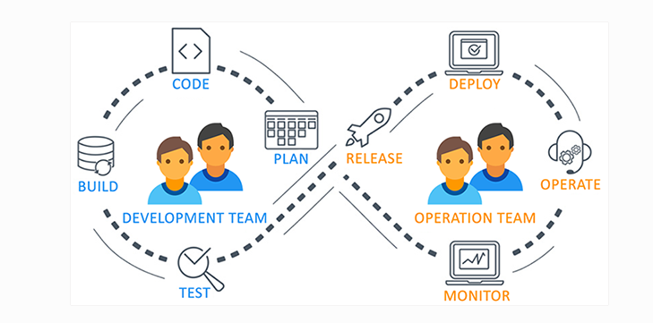
Microsoft is rebranding and repositioning its Visual Studio Team Services (VSTS) coding collaboration service as 'Azure DevOps,' VSTS users will be automatically upgraded to Azure DevOps functionality.

Slide 33
What is Azure DevOps
Azure DevOps, a modern DevOps tool of planning, developing, testing and deploying modern apps with optimized release cycle for quality delivery of applications.
Azure DevOps provides a tool which can help you to track software building progress and help you to take decision to deliver great software to end users.
Azure DevOps services are not dependent on cloud or platform.
Azure DevOps includes the following services :
Azure DevOps includes Git repositories as source control,
build and release management tools,
work planning and tracking tools,
testing tools
and support services like Slack, Trello and Azure services.

Slide 34
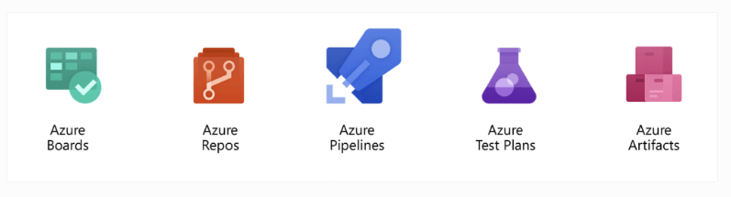

Slide 35
Azure Pipelines (Build and Release)
Azure Pipeline is a cloud-hosted pipelines for fast CI/CD that works with any language, platform, and cloud.
By connecting to any source control like GitHub, this service can release changes continuously to any cloud.
YAML files are very useful in writing build and release definitions. Azure Pipelines has components like build, release, library, task groups, deployment groups.

Slide 36
Azure Boards (Work)
Azure Boards helps to plan, track, and discuss work across the team. Azure Boards is a powerful agile tool for managing Kanban board, reporting, product backlog.
Azure boards have components like work items, backlogs, Boards, queries, sprints details.
Work item can be bug, epic, issue, task or features. This service is sprint ready and built for insights to improve productivity.
We can manage user authentication and authorization, team, project, and organization-level settings. Azure Boards helps you to write query to retrieve specific work items from the system.

Slide 37
Azure Artifacts (Packages)
Azure Artifact service manages the dependencies used in source code. Azure Artifacts can host and share package (like NPM, Nuget, Maven) feeds from public and private sources.
These artifacts simplify job building process.
These stored artifacts are easy to integrate with Azure Pipelines.
Azure Artifacts are managed package hosted on cloud and indexed.

Slide 38
Azure Repos
Azure Reops service includes unlimited cloud-hosted private Git repository for your project. This is standard Git service and works as distributed source controls.
Azure Repos supports all Git clients and all IDEs, all editor.
You may do effective Git code review, can raise pull requests.
Azure Repos supports branching strategy, so that you can we can merge the code after successful build and passing all the test case to maintain high code quality.
Access to the repositories are managed by Azure AD, hence source code access management is fast and easy.

Slide 39
Azure Test Plans
Azure test plan service helps to do automated and manual testing. Testing of an app is integral part of CI/CD and agile process. Simple XML files can be used for load testing as well.
Azure Test Plans provides manual and exploratory testing tools. Hence, executing multiple scenario based scripted test gives end to end traceability.
Test results are beneficial to record software bugs and defects.
Automated tests will typically execute in a Pipeline.
Stakeholder’s feedback can be captured in work items.

Slide 40
Benefits of Azure DevOps
Continuous Integration & Continuous Delivery (CI - CD)
When the code is committed, it automatically builds and is tested for errors, enabling bugs detection early. Business organizations can achieve fast and identical deployment to the production environment at any given time.
Automation Testing
The use of automated tests, such as security and compliance tests identify problems at the testing phase. We can quickly provision resources and configures the entire production environment in a quick time.
Any Platform, Any Language
It supports various platforms and a runs on multiple frameworks. The developers using Java, Node, PHP, .NET, and Python can efficiently work on it.
App Insights
Azure Application Insights provides insights through application performance management and instant analytics. You can monitor infrastructure health with Azure Log Analytics and Azure Monitor.

Slide 41
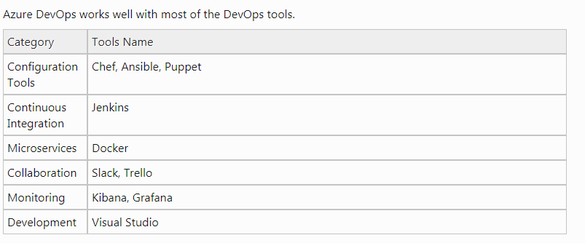
Tools for Azure DevOps

Slide 42
Summary
VSTS is IDE software developed to manage software development and deployment. VSTS is rebranded as Azure DevOps.
Azure DevOps has five components like Azure Pipelines, Azure Boards, Azure Artifacts, Azure Repos, Azure Test Plans.
Azure DevOps is free for open source projects and small projects (up to five users).
Azure DevOps helps you plan your project with Agile tools, manages your code using Git, and deploys your code through the CI/CD system

Slide 43
What is Microsoft Azure?
Azure is a cloud computing platform and an online portal that allows you to access and manage cloud services and resources provided by Microsoft. These services and resources include storing your data and transforming it, depending on your requirements. To get access to these resources and services, all you need to have is an active internet connection and the ability to connect to the Azure portal.

Slide 44
Things that you should know about Azure
It was launched on February 1, 2010, significantly later than its main competitor, AWS.
It’s free to start and follows a pay-per-use model, which means you pay only for the services you opt for.
Interestingly, 80 percent of the Fortune 500 companies use Azure services for their cloud computing needs.
Azure supports multiple programming languages, including Java, Node Js, and C#.
Another benefit of Azure is the number of data centers it has around the world. There are 42 Azure data centers spread around the globe, which is the highest number of data centers for any cloud platform. Also, Azure is planning to get 12 more data centers, which will increase the number of data centers to 54, shortly.

Slide 45
What are the Various Azure Services and How does Azure Work?
Azure provides more than 200 services, are divided into 18 categories. These categories include computing, networking, storage, IoT, migration, mobile, analytics, containers, artificial intelligence, and other machine learning, integration, management tools, developer tools, security, databases, DevOps, media identity, and web services.

Slide 46
Azure services by category:
Virtual Machine
This service enables you to create a virtual machine in Windows, Linux or any other configuration in seconds.
Cloud Service
This service lets you create scalable applications within the cloud. Once the application is deployed, everything, including provisioning, load balancing, and health monitoring, is taken care of by Azure.
Service Fabric
With service fabric, the process of developing a microservice is immensely simplified. Microservice is an application that contains other bundled smaller applications.
Functions
With functions, you can create applications in any programming language. The best part about this service is that you need not worry about hardware requirements while developing applications because Azure takes care of that. All you need to do is provide the code.

Slide 47
Networking
Azure CDN
Azure CDN (Content Delivery Network) is for delivering content to users. It uses a high bandwidth, and content can be transferred to any person around the globe. The CDN service uses a network of servers placed strategically around the globe so that the users can access the data as soon as possible.
Express Route
This service lets you connect your on-premise network to the Microsoft cloud or any other services that you want, through a private connection. So, the only communications that will happen here will be between the enterprise network and the service that you want.
Virtual network
The virtual network allows you to have any of the Azure services communicate with one another privately and securely.
Azure DNS
This service allows you to host your DNS domains or system domains on Azure.

Slide 48
Storage
Disk Storage
This service allows you to choose from either HDD (Hard Disk Drive) or SSD (Solid State Drive) as your storage option along with your virtual machine.
Blob Storage
This service is optimized to store a massive amount of unstructured data, including text and even binary data.
File Storage
This is a managed file storage service that can be accessed via industry SMB (server message block) protocol.
Queue Storage
With queue storage, you can provide stable message queuing for a large workload. This service can be accessed from anywhere in this world.

Slide 49
Why Use Azure?
Application development: You can create any web application in Azure.
Testing: After developing an application successfully on the platform, you can test it.
Application hosting: Once the testing is done, Azure can help you host the application.
Create virtual machines: You can create virtual machines in any configuration you want with the help of Azure.
Integrate and sync features: Azure lets you integrate and sync virtual devices and directories.
Collect and store metrics: Azure lets you collect and store metrics, which can help you find what works.
Virtual hard drives: These are extensions of the virtual machines; they provide a huge amount of data storage.

Slide 50
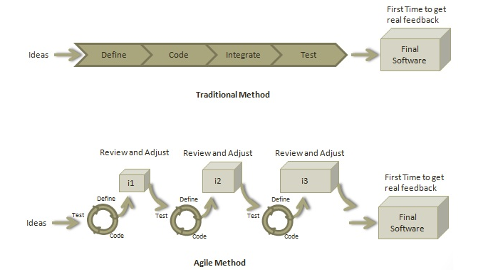
Agile Methodology
Agile is a software development methodology to build a software incrementally using short iterations of 1 to 4 weeks so that the development is aligned with the changing business needs.

Slide 51
Roles in Agile
Scrum Master
A Scrum Master is a team leader and facilitator who helps the team members to follow agile practices so that they can meet their commitments. The responsibilities of a scrum master are as follows −
To enable close co-operation between all roles and functions.
To remove any blocks.
To shield the team from any disturbances.
To work with the organization to track the progress and processes of the company.

Slide 52
To ensure that Agile Inspect & Adapt processes are leveraged properly which includes
Daily stand-ups,
Planned meetings,
Demo,
Review,
Retrospective Meetings, and
To facilitate team meetings and decision-making process.

Slide 53
Product Owner
A Product Owner is the one who drives the product from business perspective. The responsibilities or a Product Owner are as follows −
To define the requirements and prioritize their values.
To determine the release date and contents.
To take an active role in iteration planning and release planning meetings.
To ensure that team is working on the most valued requirement.
To represent the voice of the customer.
To accept the user stories that meet the definition of done and defined acceptance criteria.

Slide 54
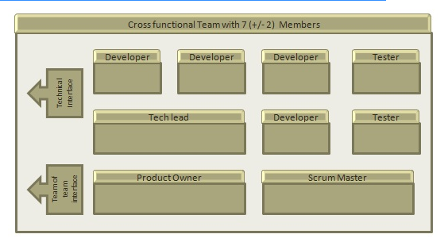
Cross-functional Team
Every agile team should be a self-sufficient team with 5 to 9 team members and an average experience ranging from of 6 to 10 years. Typically, an agile team comprises of 3 to 4 developers, 1 tester, 1 technical lead, 1 product owner and 1 scrum master.
Product Owner and Scrum master are considered to be a part of Team Interface, whereas other members are part of Technical Interface.

Slide 55
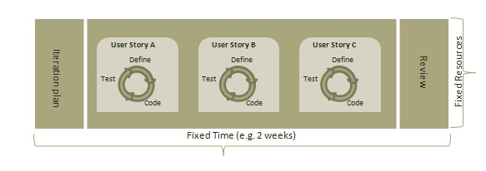
How an Agile Team Plans its Work?
An Agile team works in iterations to deliver user stories where each iteration is of 10 to 15 days. Each user story is planned based on its backlog prioritization and size. The team uses its capacity − how many hours are available with team to work on tasks − to decide how much scope they have to plan.

Slide 56
Point, Capacity
Point
A Point defines how much a team can commit. A point usually refers to 8 hours. Each story is estimated in points.
Capacity
Capacity defines how much an individual can commit. Capacity is estimated in hours.

Slide 57
What is a User Story?
A user story is a requirement which defines what is required by the user as functionality. A user story can be in two forms −
As a <User Role> I want <Functionality> so that <Business Value>
In order to <Business value> as a <User Role> I want <Functionality>
During release planning, a rough estimate is given to a user story using relative scale as points. During iteration planning, the story is broken down into tasks.

Slide 58
Relationship of User Stories and Tasks
User story talks about what is to be done. It defines what a user needs.
Task talks about how it is to be done. It defines how a functionality is to be implemented.
Stories are implemented by tasks. Each story is a collection of tasks.
User story is divided into tasks when it is planned in current iteration.
Tasks are estimated in hours, typically from 2 to 12 hours.
Stories are validated using acceptance tests.

Slide 59
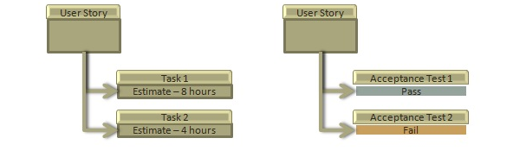
When a Story is Done
The team decides what done means. The criteria may be −
All tasks (development, testing) are completed.
All acceptance tests are running and are passed.
No defect is open.
Product owner has accepted the story.
Deliverable to the end-user.

Slide 60
What is Acceptance Criteria?
Criteria defines the functionality, behavior, and performance required by a feature so that it can be accepted by the product owner. It defines what is to be done so that the developer knows when a user story is complete.
How the Requirements are Defined?
Requirements are defined as
A User Story,
With Acceptance Criteria, and
Tasks to implement the story.

Slide 61
Twelve Principles of Agile Manifesto
Customer Satisfaction − Highest priority is given to satisfy the requirements of customers through early and continuous delivery of valuable software.
Welcome Change − Changes are inevitable during software development. Ever-changing requirements should be welcome, even late in the development phase. Agile processes should work to increase customers' competitive advantage.
Deliver a Working Software − Deliver a working software frequently, ranging from a few weeks to a few months, considering shorter time-scale.
Collaboration − Business people and developers must work together during the entire life of a project.
Motivation − Projects should be built around motivated individuals. Provide an environment to support individual team members and trust them so as to make them feel responsible to get the job done.
Face-to-face Conversation − Face-to-face conversation is the most efficient and effective method of conveying information to and within a development team.

Slide 62
Measure the Progress as per the Working Software − Working software is the key and it should be the primary measure of progress.
Maintain Constant Pace − Agile processes aim towards sustainable development. The business, the developers, and the users should be able to maintain a constant pace with the project.
Monitoring − Pay regular attention to technical excellence and good design to enhance agility.
Simplicity − Keep things simple and use simple terms to measure the work that is not completed.
Self-organized Teams − An agile team should be self-organized and should not depend heavily on other teams because the best architectures, requirements, and designs emerge from self-organized teams.
Review the Work Regularly − Review the work done at regular intervals so that the team can reflect on how to become more effective and adjust its behavior accordingly.

Slide 63
What is Daily Stand-up?
A daily stand-up is a daily status meeting among all team members and it is held roughly for 15 minutes.
Every member has to answer three important questions −
What I did yesterday?
What I'll do today?
Any impediment I am facing.../ I am blocked due to...
Daily stand-up is for status update, not for any discussion. For discussion, team members should schedule another meeting at a different time.
Participants usually stand instead of sitting so that the meeting gets over quickly.
Why Stand-up is Important?
The benefits of having a daily stand-up in agile are as follows −
The team can evaluate the progress on a daily basis and see if they can deliver as per the iteration plan.
Each team member informs all about his/ her commitments for the day.
It provides visibility to the team on any delay or obstacles.
Who Attends a Stand-up?
The scrum master, the product owner, and the delivery team should attend the stand-up on a daily basis.
Stakeholders and Customers are encouraged to attend the meeting and they can act as an observer, but they are not supposed to participate in stand-ups.
It is the scrum master's responsibility to take note of each team member's queries and the problems they are facing.

Slide 64
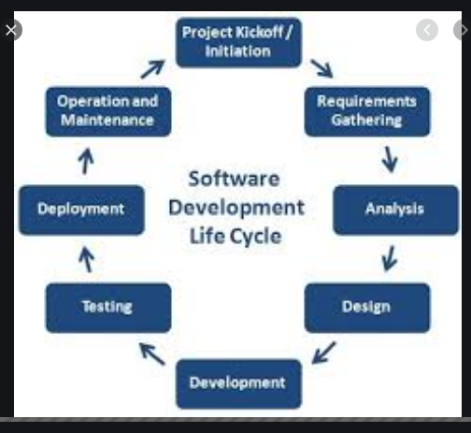
SDLC

Slide 65
Phase 1: Requirement collection and analysis:
The requirement is the first stage in the SDLC process. It is conducted by the senior team members with inputs from all the stakeholders and domain experts in the industry. Planning for the quality assurance requirements and recognization of the risks involved is also done at this stage.
Phase 2: Feasibility study:
Once the requirement analysis phase is completed the next step is to define and document software needs.

Slide 66
There are mainly five types of feasibilities checks:
Economic: Can we complete the project within the budget or not?
Legal: Can we handle this project as cyber law and other regulatory framework/compliances.
Operation feasibility: Can we create operations which is expected by the client?
Technical: Need to check whether the current computer system can support the software
Schedule: Decide that the project can be completed within the given schedule or not.

Slide 67
Phase 3: Design:
In this third phase, the system and software design documents are prepared as per the requirement specification document.
High-Level Design (HLD)
Brief description and name of each module
An outline about the functionality of every module
Interface relationship and dependencies between modules
Database tables identified along with their key elements
Complete architecture diagrams along with technology details
Low-Level Design(LLD)
Functional logic of the modules
Database tables, which include type and size
Complete detail of the interface
Addresses all types of dependency issues
Listing of error messages
Complete input and outputs for every module

Slide 68
Phase 4: Coding:
Once the system design phase is over, the next phase is coding. In this phase, developers start build the entire system by writing code using the chosen programming language. In the coding phase, tasks are divided into units or modules and assigned to the various developers. It is the longest phase of the Software Development Life Cycle process.

Slide 69
Phase 5: Testing:
Once the software is complete, and it is deployed in the testing environment. The testing team starts testing the functionality of the entire system. This is done to verify that the entire application works according to the customer requirement.

Slide 70
Phase 6: Installation/Deployment:
Once the software testing phase is over and no bugs or errors left in the system then the final deployment process starts. Based on the feedback given by the project manager, the final software is released and checked for deployment issues if any.
Phase 7: Maintenance:
Once the system is deployed, and customers start using the developed system, following 3 activities occur
Bug fixing - bugs are reported because of some scenarios which are not tested at all
Upgrade - Upgrading the application to the newer versions of the Software
Enhancement - Adding some new features into the existing software
The main focus of this SDLC phase is to ensure that needs continue to be met and that the system continues to perform as per the specification mentioned in the first phase.

Slide 71
Popular SDLC models
Waterfall model
The waterfall is a widely accepted SDLC model. In this approach, the whole process of the software development is divided into various phases. In this SDLC model, the outcome of one phase acts as the input for the next phase.
Incremental Approach
The incremental model is not a separate model. It is essentially a series of waterfall cycles. The requirements are divided into groups at the start of the project. For each group, the SDLC model is followed to develop software.

Slide 72
V-Model
In this type of SDLC model testing and the development, the phase is planned in parallel. So, there are verification phases on the side and the validation phase on the other side. V-Model joins by Coding phase.
Agile Model
Agile methodology is a practice which promotes continue interaction of development and testing during the SDLC process of any project. In the Agile method, the entire project is divided into small incremental builds. All of these builds are provided in iterations, and each iteration lasts from one to three weeks.
Spiral Model
The spiral model is a risk-driven process model. This SDLC model helps the team to adopt elements of one or more process models like a waterfall, incremental, waterfall, etc.
Big bang model
Big bang model is focusing on all types of resources in software development and coding, with no or very little planning. The requirements are understood and implemented when they come.

Slide 73
Conclusion
SDLC consists of a detailed plan which explains how to plan, build, and maintain specific software

Slide 74
Azure Services
Azure Boards
Deliver value to your users faster using proven agile tools to plan, track, and discuss work across your teams.
Azure Pipelines
Build, test, and deploy with CI/CD that works with any language, platform, and cloud. Connect to GitHub or any other Git provider and deploy continuously.

Slide 75
Azure Repos
Get unlimited, cloud-hosted private Git repos and collaborate to build better code with pull requests and advanced file management.
Azure Test Plans
Test and ship with confidence using manual and exploratory testing tools.
Azure Artifacts
Create, host, and share packages with your team, and add artifacts to your CI/CD pipelines with a single click.

Slide 76
Test Azure Devops with Github repository
https://azuredevopsdemogenerator.azurewebsites.net/

Slide 77
Traditional approach in your company with subscribed Azure / Devops and hosting
Steps

Slide 78
Step 1
Exercise 1: Setting up a sample ASP.NET project using Azure DevOps Project
Sign into the Microsoft Azure portal.
Choose the + Create a resource icon in the left navigation bar, then search for DevOps project. Then choose DevOps Project in the list. Select Create.

Slide 79
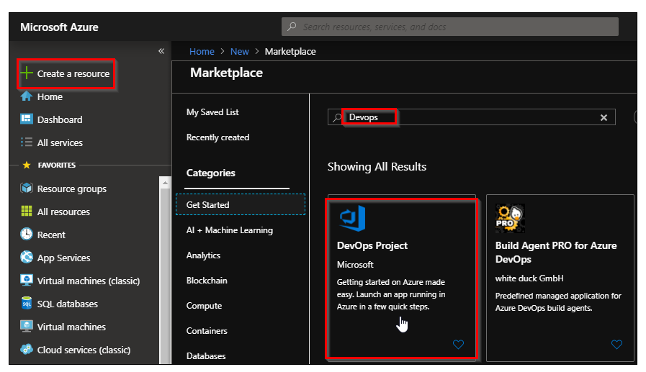

Slide 80
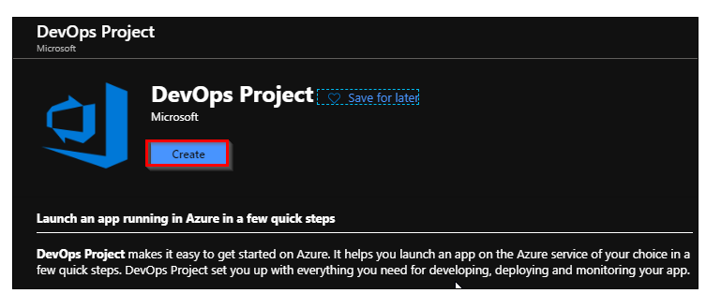

Slide 81
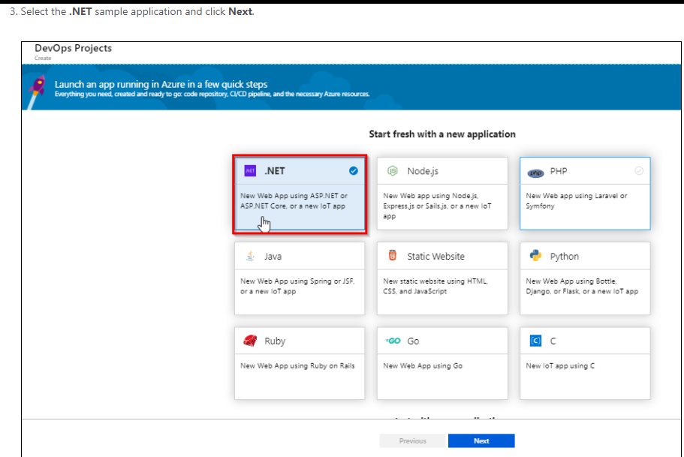

Slide 82
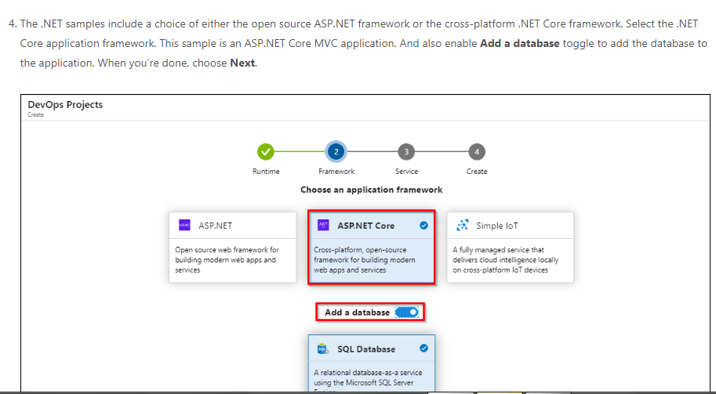

Slide 83
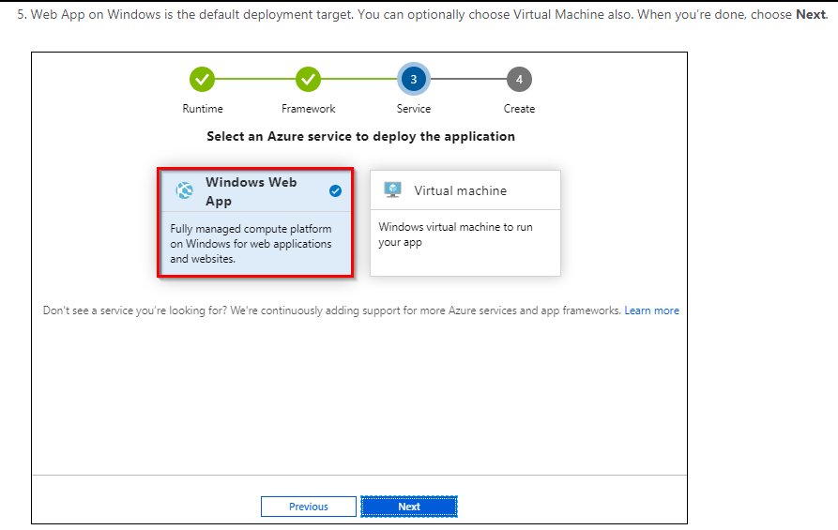

Slide 84
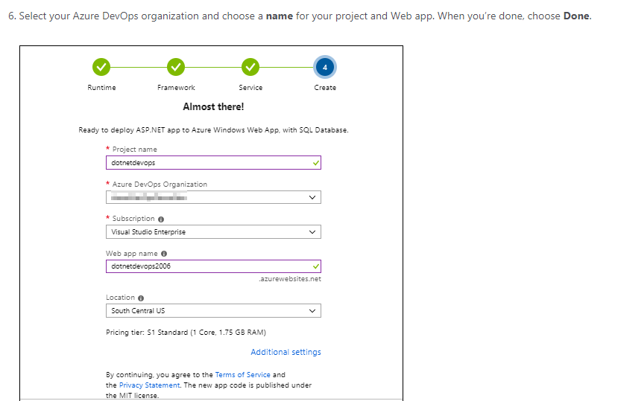

Slide 85
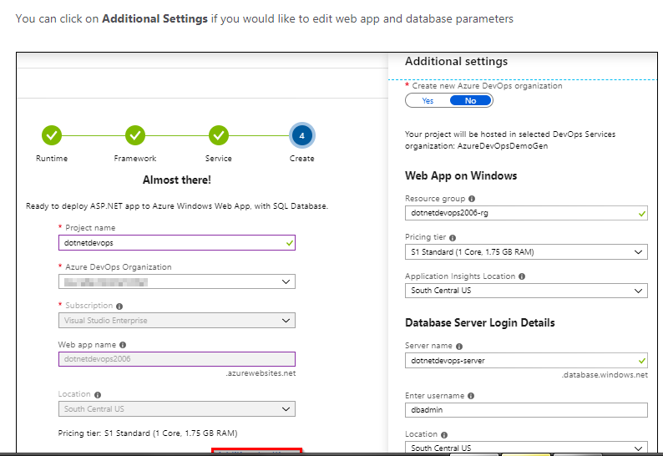

Slide 86
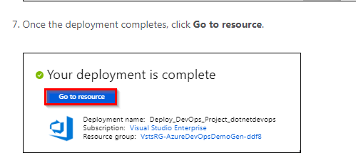

Slide 87
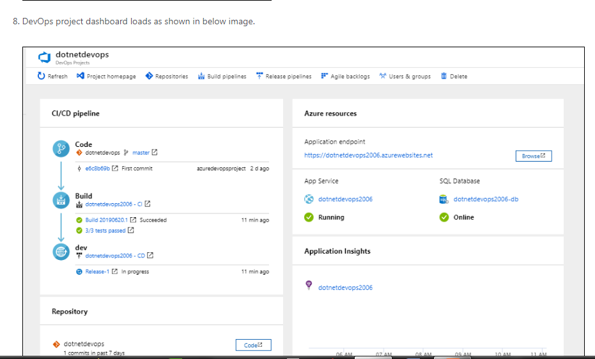

Slide 88
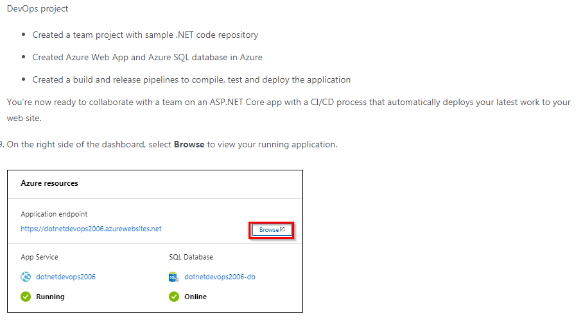

Slide 89
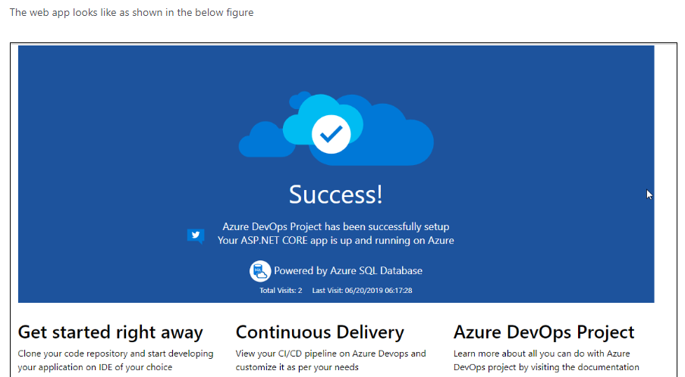

Slide 90
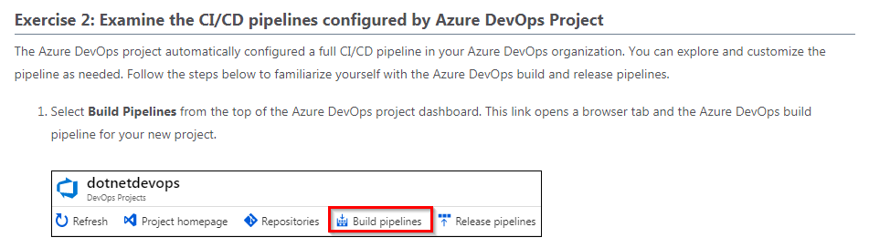
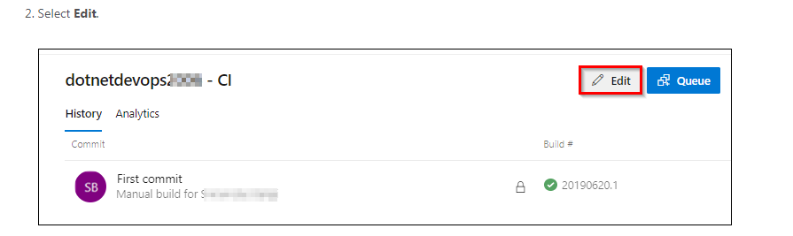

Slide 91
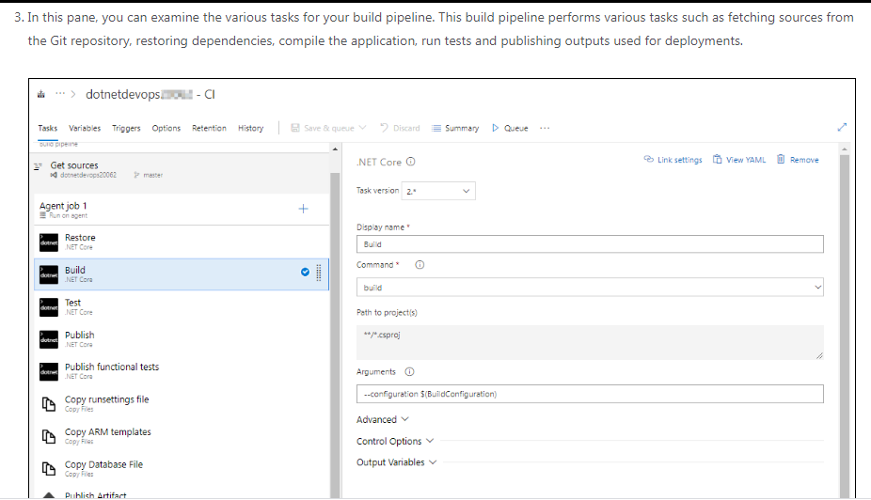

Slide 92
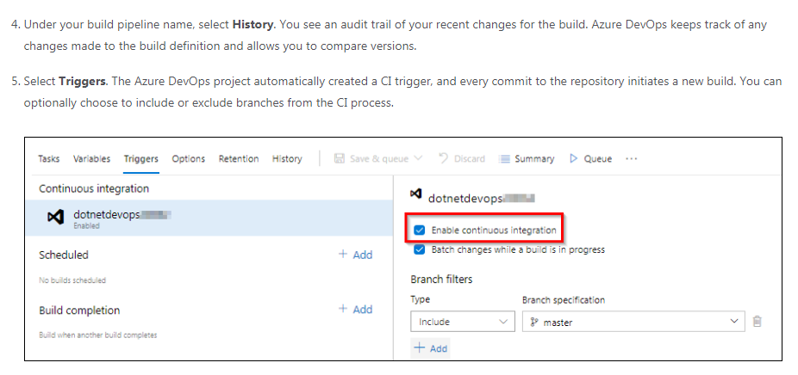

Slide 93
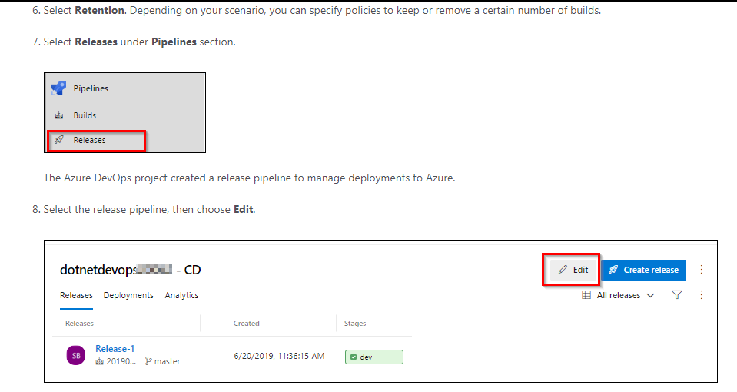

Slide 94
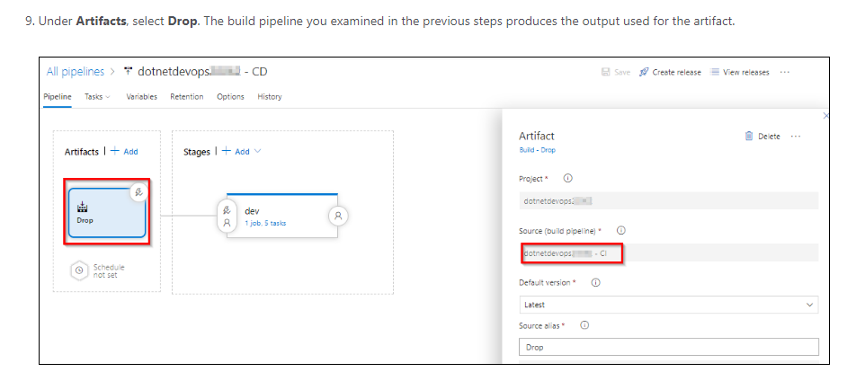

Slide 95
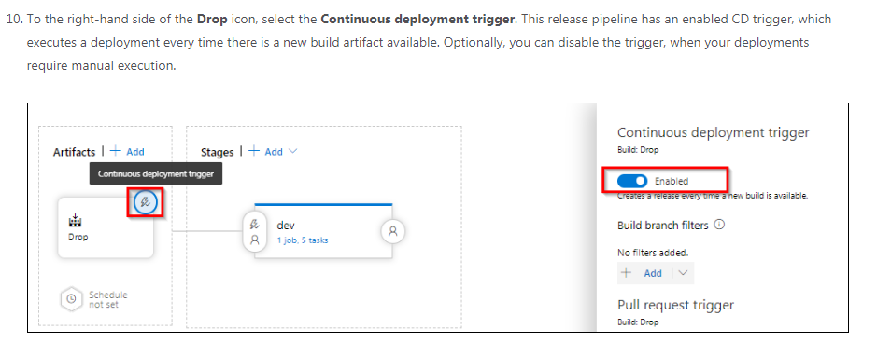
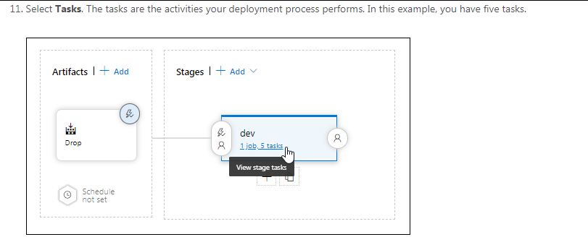

Slide 96
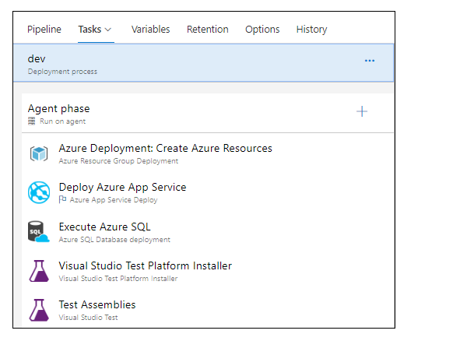
Azure Resource Group Deployment task deploy the required Azure resources, Azure Web app and Azure SQL database for the application to use.
Azure App Service Deploy task deploy the application package to the web site
Azure SQL Database deployment task deploy SQL changes to the database.
Visual Studio Test tasks run functional tests after the successful deployment of the application

Slide 97
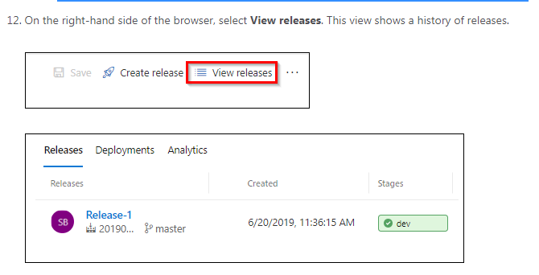

Slide 98
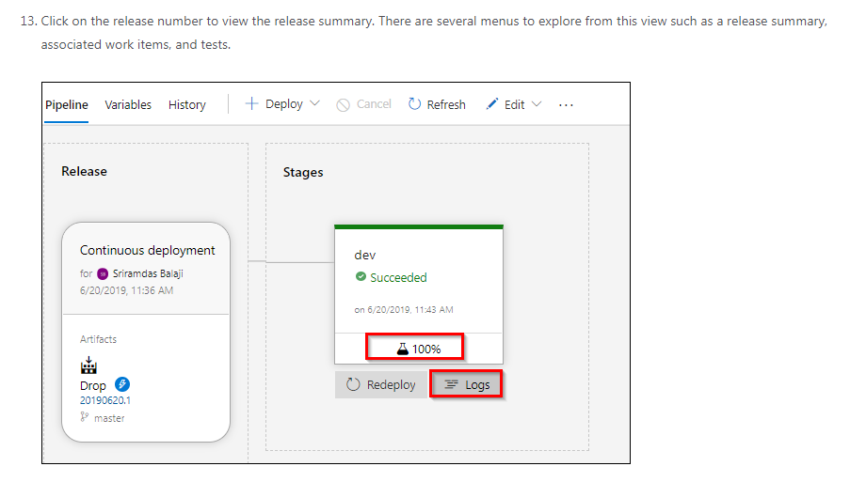
Select Logs. The logs contain useful information about the deployment process. They can be viewed both during and after deployments.

Slide 99
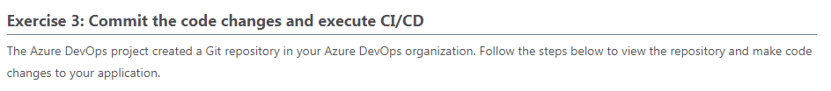
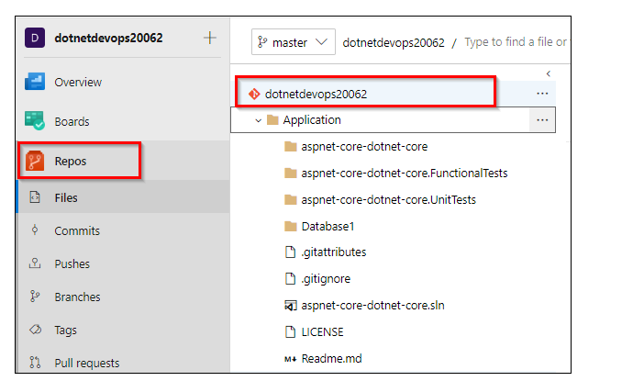

Slide 100
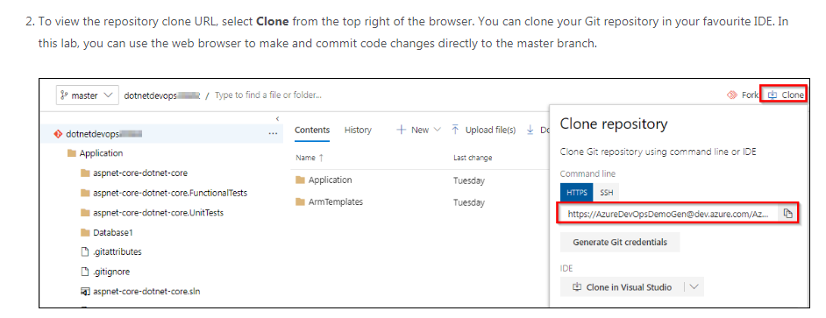

Slide 101


Slide 102



Slide 103

Finally

